Slide 1

Interpolation
Search
Searching Algortihm

Slide 2
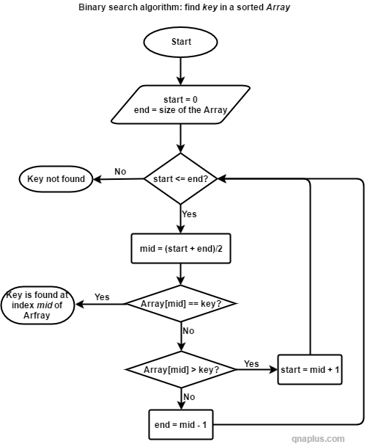

Slide 3
Binary Search
Key: 4
0
1
2
3
4
5
6
i
Sorted Array
2
4
6
8
10
12
14
Start
1
Solve for the middle index
End
0
1
2
2
4
6
2
Check if the middle value is the key value
Start
End
0
1
2
3
Repeat 2 and 3 if not yet found
Key found in index 1

Slide 4
Interpolation Search tries to find the element where it is more likely present.
key not found
key found in index [position] of arrays
No
Yes
key is in the range of array & start <= end
position = start + (key-arr[start])*(end-start)/(arr[end]-arr[end])
array[pos] = key?
if array[pos] > key?
end = pos - 1
Start = 0
End = size of the array
Yes
Yes
Start
No
start = pos + 1

Slide 5
Start
Interpolation Search tries to find the element where it is more likely present.
Start = 0
End = size of the array
key is in the range of array & start <= end
key not found
position = start + (key-arr[start])*(end-start)/(arr[end]-arr[end])
array[pos] = key?
key found in index position of arrays
start = pos + 1
array[pos] > key?
end = pos - 1

Slide 6
Binary Search
0
1
2
3
4
5
6
7
8
9
2
4
6
8
10
12
14
16
18
20
Start
End
Key: 8
Mid = (start + end) / 2

Slide 7
Binary Search
0
1
2
3
4
5
6
7
8
9
2
4
6
8
10
12
14
16
18
20
Start
End
Key: 8
Mid = (start + end) / 2

Slide 8
Binary Search
0
1
2
3
4
5
6
7
8
9
2
4
6
8
10
12
14
16
18
20
Start
End
0
1
2
3
2
4
6
8
Start
End
Key: 8
Mid = (start + end) / 2

Slide 9
Binary Search
0
1
2
3
4
5
6
7
8
9
2
4
6
8
10
12
14
16
18
20
Start
End
0
1
2
3
2
4
6
8
Start
End
Key: 8
3
Mid = (start + end) / 2
2
6
8
Start
End

Slide 10
Binary Search
0
1
2
3
4
5
6
7
8
9
2
4
6
8
10
12
14
16
18
20
Start
End
0
1
2
3
2
4
6
8
Start
End
Key: 8
3
Mid = (start + end) / 2
2
6
8
Start
End
3
8
Key found in index 3
Start
End

Slide 11
Interpolation Search
position = start + (key-arr[start])*(end-start)/(arr[end]-arr[start])

Slide 12
Interpolation Search
0
1
2
3
4
5
6
7
8
9
2
4
6
8
10
12
14
16
18
20
Start
End
Key: 8
position = start + (key-arr[start])*(end-start)/(arr[end]-arr[start])

Slide 13
Interpolation Search
0
1
2
3
4
5
6
7
8
9
2
4
6
8
10
12
14
16
18
20
Start
End
Key: 8
position = 0 + (8-2)*(9-0)/(20-2)

Slide 14
Interpolation Search
0
1
2
3
4
5
6
7
8
9
2
4
6
8
10
12
14
16
18
20
Start
End
Key: 8
position = 0 + (8-2)*(9-0)/(20-2)
position = 3
Key found in index 3

Slide 15


Binary Search
Interpolation Search

Slide 16


Slide 17
Interpolation Search
If and Only
1
Sorted Array
2
Uniformly Distributed /Highly Distributed
log(log(n))
Best Case:
O(1)
Average Case:
log(log(n))
0
1
2
3
4
5
6
2
4
6
8
10
12
14
Worst Case: O(n)
Low
End

